Slide 1


Employee Salary Analysis with Excel
Analyzing employee salaries is a crucial task for any organization. This presentation will guide you through a comprehensive analysis using Microsoft Excel, covering everything from data collection to drawing meaningful conclusions.
by DURGA DEVI A

Slide 2
Gathering & Organizing Salary Data
Importing Data
Cleaning & Formatting
Organizing Data
Import salary data from various sources like HR systems, payroll records, or CSV files. Ensure data consistency and accuracy.
Clean the data by removing duplicates, correcting errors, and applying consistent formatting. Standardize units and data types for accurate analysis.
Organize data in a clear and logical structure. Use columns for employee names, job titles, departments, salary, experience, and other relevant factors.

Slide 3
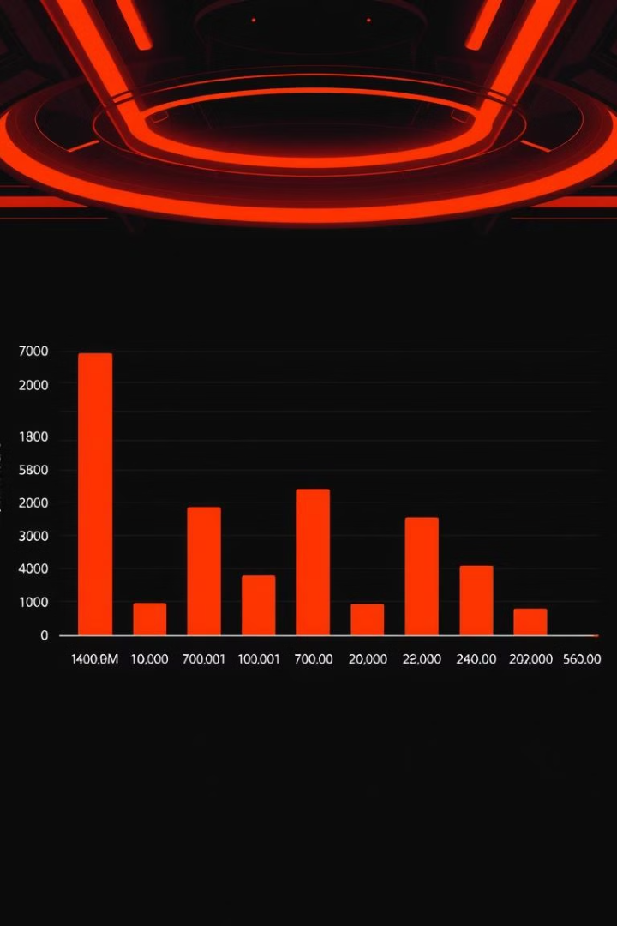
Calculating Basic Salary Statistics
1
Average Salary
2
Median Salary
Calculate the average salary to understand the overall salary level within the organization.
Determine the median salary, which represents the middle value of the salary data, providing a more accurate representation than the average in cases of skewed distributions.
3
Salary Range
4
Standard Deviation
Identify the minimum and maximum salaries to understand the spread of salaries within the organization.
Calculate the standard deviation to measure the spread of salaries around the average, providing insights into salary variations.

Slide 4

Visualizing Salary Data
Bar Charts
Line Charts
Use bar charts to compare salaries across different departments, job titles, or experience levels. Clearly visualize salary variations.
Represent salary trends over time, showing salary growth patterns and identifying potential salary stagnation or decline.
Scatter Plots
Histograms
Analyze the relationship between salary and other factors like experience, performance, or education level. Identify potential correlations.
Visualize the distribution of salaries within the organization. Identify clusters and potential outliers in salary data.

Slide 5

Identifying Trends & Patterns in Salaries
Salary Growth
1
Analyze salary growth patterns over time. Identify periods of rapid growth or stagnation. Understand the factors influencing salary growth.
2
Salary Compression
Analyze potential salary compression, where employees with different experience levels or performance have similar salaries. Identify potential issues and solutions.
Salary Gaps
3
Analyze potential salary gaps across different departments, roles, or demographic groups. Identify areas for salary adjustments and ensure fairness.

Slide 6
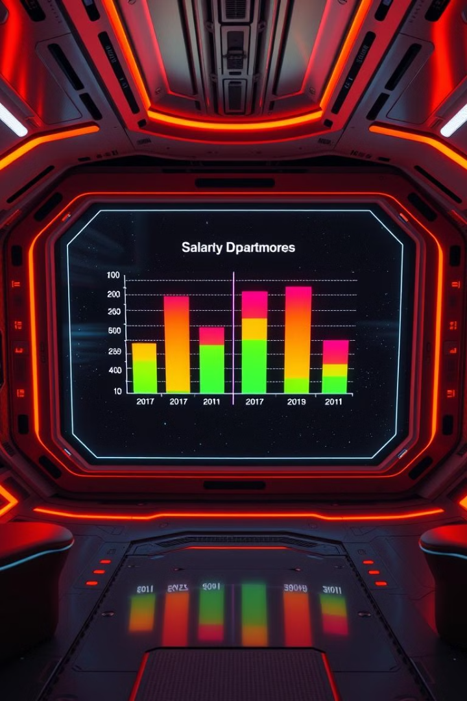
Comparing Salaries Across Departments or Roles
Department
Average Salary
Median Salary
Salary Range
Sales
$75,000
$70,000
$60,000 - $90,000
Marketing
$68,000
$65,000
$55,000 - $80,000
Engineering
$82,000
$80,000
$70,000 - $95,000

Slide 7
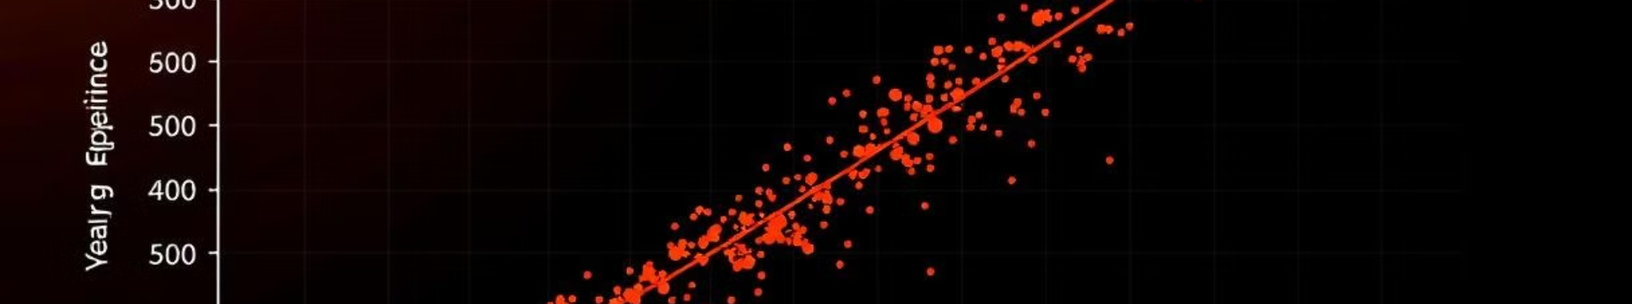



Analyzing Factors Influencing Salaries
Experience
Performance
Education
Analyze the impact of experience on salary levels. Identify potential correlations between years of experience and salary growth.
Analyze the impact of performance on salary levels. Identify potential correlations between performance ratings and salary increases.
Analyze the impact of education level on salary levels. Identify potential correlations between education and salary potential.

Slide 8





Conclusions & Recommendations
Salary Adjustments
Regular Reviews
Based on the analysis, recommend salary adjustments to address salary gaps, compression, or other identified issues.
Recommend regular salary reviews to ensure that salaries remain competitive and reflect market conditions.
Data-Driven Decisions
Employee Communication
Emphasize the importance of data-driven decisions in salary management, promoting fairness and transparency.
Recommend transparent communication with employees about salary adjustments and the rationale behind them.

